Slide 1

DriverPass System Analysis
[Alex Roberts]
Notes:
[No speaker notes required for this slide.]

Slide 2

System Requirements
Functional requirements:
The system shall allow admins to access all information going in and out
The system shall allow multiple OS and platforms
Non-functional requirements:
The system will need to adapt to updates and we can ensure this by making our code flexible and keeping in mind what we may need to fix later. Planning updates ahead of time would be beneficial.
We can consider two-factor authentication and security questions for optimal security
Notes:
The admin (or business owner) will have full access to the system and be able to see all information including user profiles, their progress, driver information, and any changes that have been made to the system. This system will be available on PC, mobile phones, and tablets. If possible we need to try to plan updates ahead of time but we are going to make our code flexible so we can make changes to the system and release updates frequently with minimal complications. Two-factor authentication would be a good idea for user so they can have more security for their profile. We could do this in the form of security questions or verification codes.

Slide 3
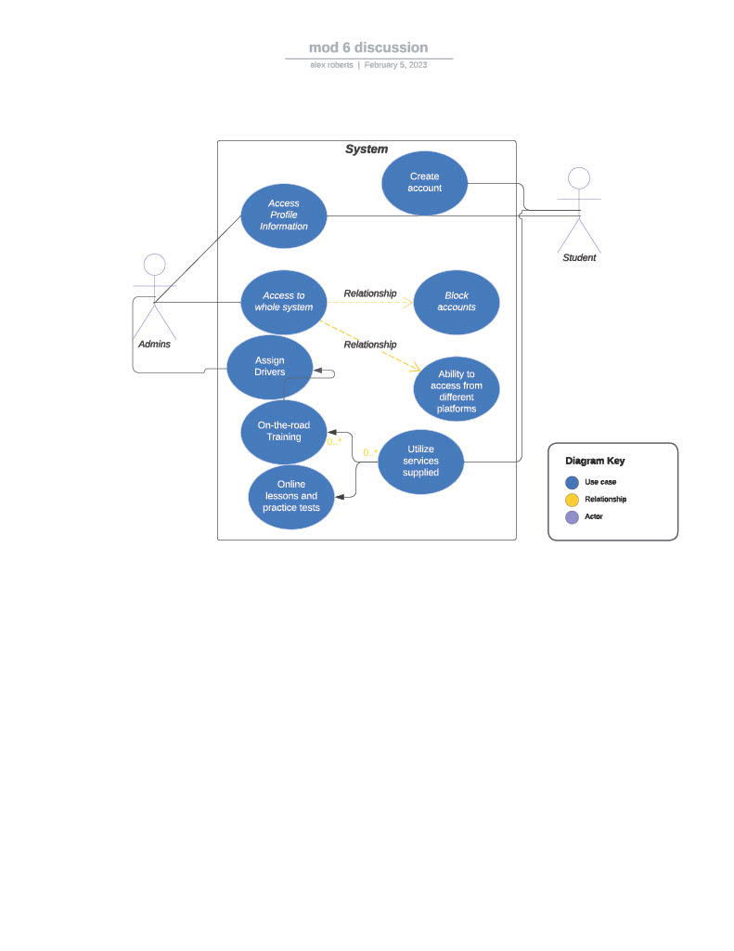
Use Case Diagram
Notes:
The actors in this diagram are the admin(owner) and the students. This diagram shows that the admin has access to the full system including student profiles so they can keep track of their progress. The students are able to create an account that holds all of their information and tracks their progress. The admin will be able to block accounts for security purposes. The admin can also assign drivers to students for driving practice.

Slide 4
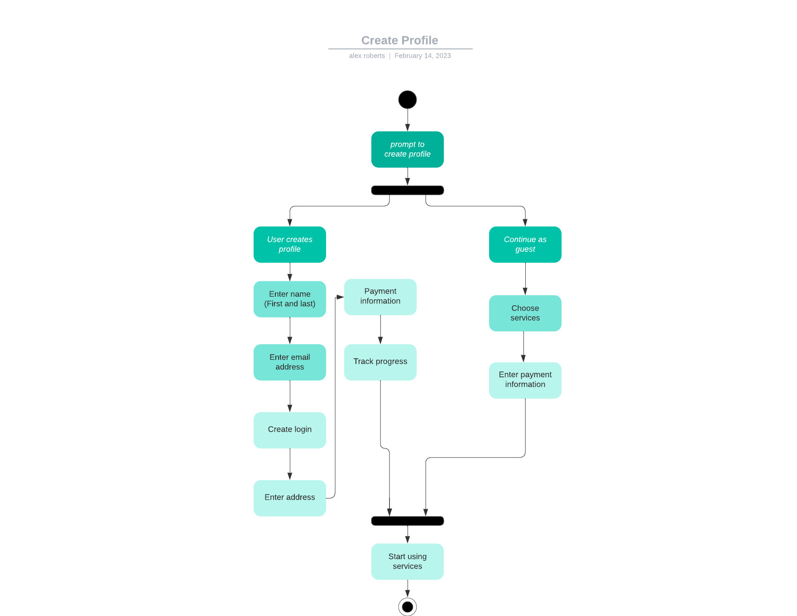
Activity Diagram
Notes:
This diagram shows the process of a user creating a profile on the system. The user chooses to create their profile, enters their name and email address. The user can create a username and password. They can then add their address and payment information. They can also track all of their progress through the various services.

Slide 5
Security
Email and password will be required to login
We can consider two-factor authentication and security questions for optimal security
If there is too many login attempts (five) or if the two-factor authentication fails the account will be locked and they will have to contact the admins (which will be provided) and they will have to provide information and answers to security questions to unlock it.
If the user forgets their password they can contact an admin or go through a “forgot password” process that will ask security questions
Notes:
Security is one of the most important parts of any online system. We need to ensure that we are implementing systems to protect the users and the business. Using these security measure can help to prevent hacking and leaking user information.

Slide 6
System Limitations
We have four months to complete this project
Need to ensure that we have enough members of the team to complete this within the time limit
Need to ensure that we have enough resources including money to be able to complete this project and pay out the team members
Need to ensure that everybody on the team is savvy to the technology we are using
Notes:
With a well equipped and trained team and the necessary resources we can ensure that this system is done efficiently and in a timely manner.

